Slide 1

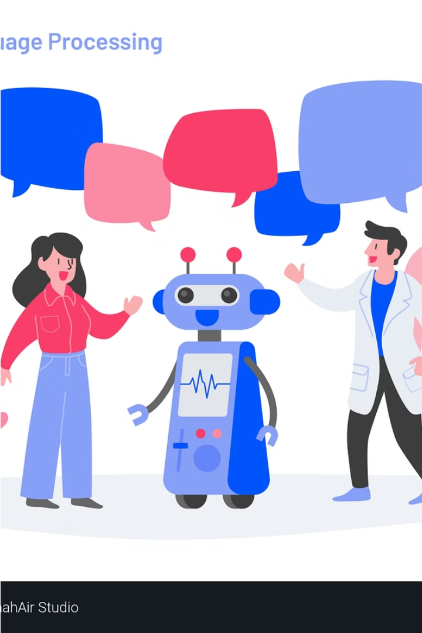

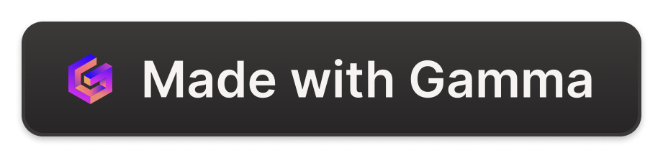
Introduction to Natural Language Processing
Natural Language Processing (NLP) is a field of artificial intelligence that enables computers to understand, interpret and generate human language. It combines linguistics, computer science and machine learning to create intelligent systems that can communicate with people.
by Regina SABS

Slide 2
Fundamentals of NLP
Linguistic Analysis
Statistical Modeling
Semantic Understanding
NLP systems break down language into its core components like phonemes, morphemes, words, sentences and paragraphs to understand the structure and meaning.
Machine learning algorithms are used to train NLP models on large language datasets, allowing them to recognize patterns and make predictions.
NLP goes beyond just recognizing words, but also comprehends the contextual meaning and relationships between them.

Slide 3
Linguistic Analysis
Linguistic analysis involves understanding the structure, grammar, and semantics of human language. It provides the foundation for NLP tasks.
1. Morphology: Study of word formation and structure.
Example: Breaking down 'unhappiness' into 'un-', 'happy', and '-ness'.
2. Syntax: Analysis of sentence structure and grammatical relationships.
Example: Identifying the subject, verb, and object in 'The cat sat on the mat.'
3. Semantics: Understanding the meaning of words and sentences.
Example: Differentiating between synonyms like 'big' and 'large' based on context.
4. Pragmatics: Understanding language in context and intended meaning.
Example: Interpreting 'Can you pass the salt?' as a request, not a question about ability.
5. Phonology and Phonetics: Study of sounds in spoken language and their production.
Example: Analyzing the phonetic structure of 'cat' to understand pronunciation.
6. Tokenization: Breaking text into smaller units (tokens).
Example: "The cat sat on the mat." becomes ["The", "cat", "sat", "on", "the", "mat", "."]
7. Part-of-Speech Tagging (POS): Labeling words as nouns, verbs, etc.
Example: “Everything to permit us.” will be labelled as noun, infinite marker, verb, personal pronoun

Slide 4
Statistical Modeling
Statistical models learn patterns from data to make predictions or decisions. Statistical Modeling involves using mathematical techniques to analyze and predict language patterns. It is crucial for building NLP applications that require pattern recognition and data-driven decision-making.
1. N-grams: Models predicting the next item in a sequence based on previous items.
Example: In 'I am going to', a bigram model might predict 'the' or 'school' as the next word.
2. Probabilistic Models: Use probabilities to model language and predict outcomes.
Example: Hidden Markov Models (HMMs) for part-of-speech tagging.
3. Machine Learning Algorithms:
- Naive Bayes: Simple probabilistic classifier based on Bayes' theorem.
- Support Vector Machines (SVM): Supervised learning model for classification tasks.
- Random Forest: Ensemble learning method for classification and regression.
4. Deep Learning Models:
- Neural Networks: Models like RNNs and LSTMs for sequence prediction.
- Transformers: Advanced models like BERT and GPT for understanding context and generating text.

Slide 5
Semantic Understanding
NLP goes beyond just recognizing words, but also comprehends the contextual meaning and relationships between them. It involves interpreting the meaning behind words, sentences, and larger text structures.
1. Word Sense Disambiguation: Identifying the correct meaning of a word based on context.
Example: Determining whether 'bank' refers to a financial institution or the side of a river.
2. Named Entity Recognition (NER): Identifying and classifying entities like names, dates, and locations in text.
Example: Extracting 'Barack Obama' as a person and 'Washington D.C.' as a location.
3. Semantic Role Labeling: Assigning roles to words in a sentence to understand their function.
Example: In 'John gave Mary a book,' identifying 'John' as the giver, 'Mary' as the recipient, and 'book' as the object.
4. Coreference Resolution: Determining when different words refer to the same entity.
Example: Linking 'he' and 'John' in the sentences 'John went to the store. He bought milk.'
5. Contextual Embeddings: Using models like BERT to capture word meanings based on context.
Example: Understanding the word 'apple' in 'She ate an apple' vs. 'Apple released a new iPhone.’
6. Sentiment Analysis: Detecting emotions in text.
Example: "I had a wonderful experience at the new restaurant. The food was delicious, and the staff were very friendly and helpful.“ will give the overall sentiment as positive.

Slide 6
Application Areas of NLP
Autocorrect and Spell-check: NLP ensures accurate spelling and grammar by auto-correcting misspelled words in text editors and applications like Microsoft Word or Grammarly.
Text Classification: NLP categorizes and organizes text data, making it useful for tasks like survey responses, spam filtering, genre classification, and language identification.
Sentiment Analysis: NLP analyzes patterns in speech and conversation to determine sentiment (positive, negative, neutral). It’s used for social media monitoring, brand reputation analysis, and customer feedback assessment.
Question Answering: NLP powers chatbots and virtual assistants that provide accurate answers to user queries based on context.

Slide 7
Application Areas of NLP contd.
Marketing is the study and management of exchange relationships. Marketing is the business process of creating relationships with and satisfying customers.
Named Entity Recognition (NER): NLP identifies and extracts entities (such as names of people, organizations, locations) from unstructured text. It’s essential for information retrieval and knowledge extraction.
Topic Modeling: NLP discovers latent topics within a collection of documents. It’s used for content recommendation, news summarization, and understanding document themes.
Speech Recognition and Synthesis: NLP converts spoken language into text (speech-to-text) and vice versa (text-to-speech). Applications include voice assistants, transcription services, and voice-controlled systems.
Information Extraction: NLP extracts structured information from unstructured text. It’s used in extracting facts from news articles, legal documents, and scientific papers.
Machine Translation: NLP enables automatic translation between languages. Google Translate and other language translation tools rely on NLP techniques

Slide 8
Task to be Done:
Each group should come up with 2 applications (e.g., chatbots, sentiment analysis, machine translation, information retrieval, healthcare, finance) and explain how NLP is used in those scenarios. how NLP improves the functionality of their assigned application.
a. How NLP is used in that area.
b. List down potential use cases and benefits of the chosen area
c. Examples of systems or applications (include real-world examples )
d. Benefits and challenges.
e. How NLP improves the functionality of their assigned application

Slide 9
NLP Architecture

Slide 10
Pipeline View of NLP Components

Slide 11
Stages in NLP

Slide 12
Text Preprocessing Techniques
1
Tokenization
2
Stemming
Breaking text into individual words, phrases or other meaningful elements.
Reducing words to their base or root form to improve pattern matching.
3
Lemmatization
4
Stop Word Removal
Lemmatization is the process of reducing words to their base or dictionary form
Removing common words that don't carry much meaning, like "the", "a", "and".

Slide 13
Tokenization
Tokenization is the process of breaking down a text into smaller units called tokens.
Tokens can be words, phrases, or even characters.
Tokenization is a fundamental step in text pre-processing that prepares the text for further analysis.
It helps in transforming the text into a format that is easier to analyze, such as by a machine learning model.

Slide 14
Types of Tokenization
Word Tokenization: Splits text into individual words.
Example: "Natural Language Processing is fun!" becomes ["Natural", "Language", "Processing", "is", "fun", "!"].
Sentence Tokenization: Splits text into individual sentences.
Example: "Hello world. NLP is fascinating." becomes ["Hello world.", "NLP is fascinating."]
Tokenize sentences of different languages.
One can also tokenize sentences from different languages using different pickle file other than English

Slide 15
Stemming
Stemming is the process of reducing words to their base or root form, often by removing suffixes.
Stemming reduces inflectional forms and derivationally related forms of a word to a common base form.
It helps in reducing the complexity of the text and improving the efficiency of text-processing tasks.
The input to the stemmer is tokenized words

Slide 16
Common Algorithms for Stemming
Porter Stemmer: Uses a series of rules to iteratively reduce words to their stems.
Snowball Stemmer: An improvement on the Porter Stemmer with more rules.
Example:
Words: "running", "runner", "ran“
Stemmed: "run“
Words: “flying”, ”flies”, “flew”
Stemmed: “fly”

Slide 17
Porter’s Stemmer Algorithm
It is one of the most popular stemming methods proposed in 1980
It is based on the idea that the suffixes in the English language are made up of a combination of smaller and simpler suffixes.
This stemmer is known for its speed and simplicity.
The main applications of Porter Stemmer include data mining and Information retrieval.
Applications are only limited to English words

Slide 18
Lemmatization
Lemmatization is the process of reducing words to their base or dictionary form (lemma).
Unlike stemming, lemmatization considers the context and the morphological analysis of the words.
Lemmatization provides more accurate base forms of words compared to stemming.
It is particularly useful in tasks that require understanding the context and meaning of words.

Slide 19
Lemmatization Example
Wordnet links words into semantic relations. ( eg. synonyms )
It groups synonyms in the form of synsets.
synsets : a group of data elements that are semantically equivalent.
Words: “am”
Lemmatized: “me”
Words: “better”
Lemmatized: “good”

Slide 20
Lemmatization Libraries
WordNet: WordNet is a lexical database for the English language that helps in finding the base form of words (lemmas). The WordNet lemmatizer uses this database to perform lemmatization.
TextBlob: A simple NLP library built on top of NLTK and Pattern. It provides a basic lemmatizer that can convert words to their lemmas
TextBlob (with POS tag): When provided with part-of-speech (POS) tags, TextBlob's lemmatizer can perform more accurate lemmatization, as the correct lemma often depends on the word's POS.
spaCy: A robust NLP library that includes a powerful lemmatizer. It uses both rules and lookup tables for lemmatization and can handle various languages

Slide 21
Lemmatization Tools
TreeTagger: A tool for annotating text with POS and lemma information. It is not a Python library but can be interfaced with Python. It supports multiple languages and is known for its accuracy.
Pattern: A web mining module for Python that includes tools for NLP. It provides a lemmatizer that is useful for basic text processing tasks
Stanford CoreNLP: A suite of NLP tools that provides state-of-the-art lemmatization among other features. It can be used via a Python wrapper and supports multiple languages.

Slide 22
Wordnet Lemmatizer
Wordnet is a publicly available lexical database of over 200 languages that provides semantic relationships between its words.
It is one of the earliest and most commonly used lemmatizer technique.
It is present in the nltk library in python.
Wordnet links words into semantic relations. ( eg. synonyms )
It groups synonyms in the form of synsets.
synsets : a group of data elements that are semantically equivalent.

Slide 23
Stop Word Removal
Stop words are commonly used words (such as "the", "is", "in") that carry little meaningful information.
Stop word removal is the process of filtering out these words from the text.
Removing stop words reduces the dimensionality of the text data.
It helps in focusing on the more meaningful words, which can improve the performance of text analysis tasks.

Slide 24
List of Stop Words
Most NLP libraries (like NLTK, SpaCy) provide pre-defined lists of stop words.
Example:
Original text: "This is an example of text pre-processing."
After stop word removal: "example text pre-processing.“
Original text: "The cat sat on the mat."
After stop word removal: “cat sat mat."

Slide 25
In Python
import nltk
nltk.download('punkt')
nltk.download('wordnet')
nltk.download('stopwords')

Slide 26
In Python
Punkt Tokenizer: This is used for dividing a text into a list of sentences. It’s trained to understand the abbreviations, initials, and acronyms to decide where sentences end. It’s essential for tokenization because it helps in accurately finding sentence boundaries.
WordNet: It’s a large lexical database of English. Nouns, verbs, adjectives, and adverbs are grouped into sets of cognitive synonyms (synsets), each expressing a distinct concept. WordNet can be used for lemmatization as it provides the base or root form of words.
Stopwords: These are common words that are usually filtered out before processing natural language data (text). They are words like ‘is’, ‘and’, ‘the’, etc., which don’t contribute much to the meaning of a sentence and are thus removed during preprocessing.

Slide 27
Tokenization
from nltk.tokenize import word_tokenize
text = "Your example sentence here."
tokens = word_tokenize(text)

Slide 28
Stemming
from nltk.stem import PorterStemmer
stemmer = PorterStemmer()
stems = [stemmer.stem(token) for token in tokens]

Slide 29
Lemmatization
from nltk.stem import WordNetLemmatizer
lemmatizer = WordNetLemmatizer()
lemmas = [lemmatizer.lemmatize(token) for token in tokens]

Slide 30
Stop Word Removal
from nltk.corpus import stopwords
stop_words = set(stopwords.words('english'))
filtered_tokens = [token for token in tokens if not token in stop_words]

Slide 31
NLP Libraries from Python
NLTK https://www.nltk.org/
SpaCy https://spacy.io/
Gensim https://radimrehurek.com/gensim/

Slide 32
Tokenization Packages
Library | Package | Tokenization Function | Example
NLTK | nltk.tokenize | word_tokenize, sent_tokenize | nltk.tokenize.word_tokenize("This is a test.")
SpaCy | spacy | nlp, nlp.tokenizer | nlp = spacy.load("en_core_web_sm") doc = nlp("This is a test.") [token.text for token in doc]
Gensim | gensim.utils | tokenize, simple_preprocess | gensim.utils.tokenize("This is a test.") gensim.utils.simple_preprocess("This is a test.")

Slide 33
Tokenization Examples
import nltk
from nltk.tokenize import word_tokenize, sent_tokenize
text = "This is a test. This is another test."
word_tokens = word_tokenize(text)
sentence_tokens = sent_tokenize(text)
print("Word Tokens:", word_tokens)
print("Sentence Tokens:", sentence_tokens)
import spacy
nlp = spacy.load("en_core_web_sm")
doc = nlp("This is a test. This is another test.")
word_tokens = [token.text for token in doc]
print("Word Tokens:", word_tokens)
from gensim.utils import tokenize, simple_preprocess
text = "This is a test. This is another test."
tokens = list(tokenize(text))
simple_tokens = simple_preprocess(text)
print("Tokens:", tokens)
print("Simple Preprocess Tokens:", simple_tokens)

Slide 34
Stemming Packages
Library | Package | Tokenization Function | Example
NLTK | nltk.stem | PorterStemmer, LancasterStemmer | PorterStemmer().stem("running")
SpaCy | spacy-lookups-data | Lookups for lemmas and morphs (note: SpaCy primarily supports lemmatization, not stemming directly) | nlp.vocab.morphology.tag_map["VBZ"]["lemma"]
Gensim | gensim.parsing.preprocessing | preprocess_string (includes a stemmer in its pipeline) | preprocess_string("running")

Slide 35
Stemming Examples
from nltk.stem import PorterStemmer, LancasterStemmer
text = "running runs ran"
porter_stemmer = PorterStemmer()
lancaster_stemmer = LancasterStemmer()
print("Porter Stemmer:", [porter_stemmer.stem(word) for word in text.split()])
print("Lancaster Stemmer:", [lancaster_stemmer.stem(word) for word in text.split()])
import spacy
nlp = spacy.load("en_core_web_sm")
doc = nlp("running runs ran")
lemmas = [token.lemma_ for token in doc]
print("Lemmas:", lemmas)
from gensim.parsing.preprocessing import preprocess_string
text = "running runs ran"
tokens = preprocess_string(text)
print("Gensim Preprocess String:", tokens)

Slide 36
Lemmatization Packages
Library | Package | Tokenization Function | Example
NLTK | nltk.stem | WordNetLemmatizer | WordNetLemmatizer().lemmatize("running", pos='v')
SpaCy | spacy | nlp, token.lemma_ | nlp = spacy.load("en_core_web_sm") doc = nlp("running") [token.lemma_ for token in doc]
Gensim | gensim.utils | lemmatize | gensim.utils.lemmatize("running")

Slide 37
Lemmatization Examples
from nltk.stem import WordNetLemmatizer
from nltk.corpus import wordnet
lemmatizer = WordNetLemmatizer()
print(lemmatizer.lemmatize("running", pos=wordnet.VERB)) # Output: 'run'
print(lemmatizer.lemmatize("better", pos=wordnet.ADJ)) # Output: 'good'
import spacy
nlp = spacy.load("en_core_web_sm")
doc = nlp("running runs ran better")
lemmas = [token.lemma_ for token in doc]
print("Lemmas:", lemmas) # Output: ['run', 'run', 'run', 'well']
from gensim.utils import lemmatize
text = "running runs ran better"
lemmatized_tokens = lemmatize(text)
print("Lemmatized Tokens:", lemmatized_tokens) # Output: ['run/v', 'run/v', 'run/v', 'better/r']

Slide 38
Stop Word Removal Packages
Library | Package | Tokenization Function | Example
NLTK | nltk.corpus | stopwords.words | from nltk.corpus import stopwords stopwords.words('english')
SpaCy | spacy | nlp.Defaults.stop_words | import spacy nlp = spacy.load("en_core_web_sm") nlp.Defaults.stop_words
Gensim | gensim.parsing.preprocessing | STOPWORDS | from gensim.parsing.preprocessing import STOPWORDS STOPWORDS

Slide 39
Stop Word Removal Examples
from nltk.corpus import stopwords
from nltk.tokenize import word_tokenize
stop_words = set(stopwords.words('english'))
text = "This is a sample sentence, showing off the stop words filtration."
word_tokens = word_tokenize(text)
filtered_sentence = [w for w in word_tokens if not w.lower() in stop_words]
print("Filtered Sentence:", filtered_sentence)
# Output: ['This', 'sample', 'sentence', ',', 'showing', 'stop', 'words', 'filtration', '.']
import spacy
nlp = spacy.load("en_core_web_sm")
stop_words = nlp.Defaults.stop_words
text = "This is a sample sentence, showing off the stop words filtration."
doc = nlp(text)
filtered_sentence = [token.text for token in doc if not token.is_stop]
print("Filtered Sentence:", filtered_sentence)
# Output: ['sample', 'sentence', ',', 'showing', 'stop', 'words', 'filtration', '.']
from gensim.parsing.preprocessing import STOPWORDS
text = "This is a sample sentence, showing off the stop words filtration."
tokens = text.split()
filtered_sentence = [word for word in tokens if word.lower() not in STOPWORDS]
print("Filtered Sentence:", filtered_sentence)
# Output: ['sample', 'sentence', 'showing', 'stop', 'words', 'filtration.']

Slide 40




Challenges and Limitations in NLP
Ambiguity
Text can have multiple meanings depending on context, making it difficult to disambiguate.
Linguistic Variation
Dialects, idioms, and informal language pose challenges for NLP systems.
Commonsense Reasoning
Extracting deeper, implicit meaning requires human-level understanding that is hard to model.

Slide 41
CADL 1
With a text corpus (e.g., a collection of news articles or social media posts), perform the following pre-processing steps using Python libraries (NLTK, SpaCy):
Tokenization, Stemming, Lemmatization, and Stop word removal.
Document the code and the results of each pre-processing step and upload their GitHub link in a padlet.

